Slide 1
CHAPTER-5 DESIGN OF SHAFTS
Tribhuwan University
Institute of Engineering
Pulchowk Campus

Slide 2
DESIGN OF SHAFT BASED ON Minimum shear stress theory
Q.1. The layout of an intermediate shaft of a gear box supporting two spur gears B and C is shown in figure below. The shaft is mounted on two bearings A and D. The pitch circle diameters of gears B and C are 900 and 600 mm respectively. The material of the shaft is steel FeE 580 (S_{ut} = 770 N/mm² and S_{yt} = 580 N/mm²). The factors k_{b} and k_{t} of ASME code are 1.5 and 2.0 respectively. Determine the shaft diameter using the ASME code.
Assume that the gears are connected to the shaft by means of keys.

Slide 3
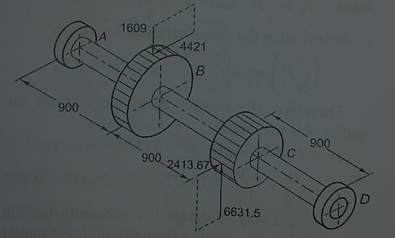
DESIGN OF SHAFT BASED ON Minimum shear stress theory

Slide 4
Steps involved
Permissible (or Allowable) Shear Stress.
Load (Vertical and Horizontal), Bending Moment (Vertical and horizontal) and Torsional Diagram.
Resultant Bending Moment from the Horizontal and Vertical Moment Diagram.
Shaft diameter using ASME Code.

Slide 5
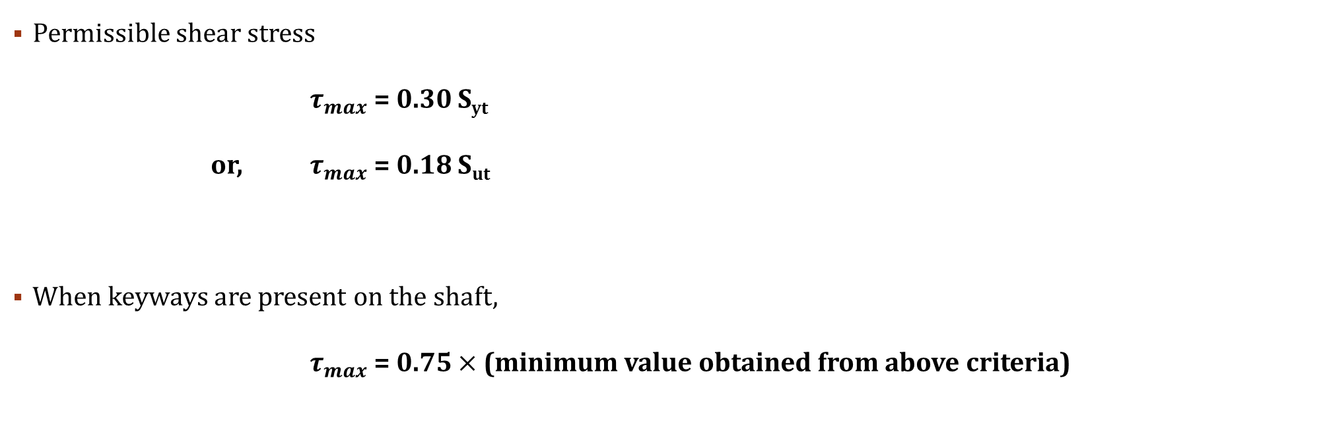
Permissible (or allowable) shear stress
Permissible shear stress
$τ_{max}$ = 0.30 S_{yt}
or, $τ_{max}$ = 0.18 S_{ut}
When keyways are present on the shaft,
$τ_{max}$ = 0.75 $×$ (minimum value obtained from above criteria)
Choose whichever has minimum value

Slide 6
Load Diagram (vertical and horizontal plane)
Vertical Plane (Load Diagram)
y
Horizontal Plane (Load Diagram)
x
1609 N
x
A_{z}
4421 N
D_{z}
z
A
B
C
D
A
B
C
D
900 mm
900 mm
900 mm
900 mm
900 mm
900 mm
A_{y}
6631.5 N
D_{y}
2413.67 N
Ay = -1137.83 N
Dy = -3884.67 N
Az = -2142.78 N
Dz = 135.45 N
Guiding Equations
Ay + Dy + 6631.5 -1609 = 0
-1609 (900) + 6631.5 (1800) + Dy (2700) = 0
Guiding Equations
Az + 4421 – 2413.67 + Dz = 0
-4421 (900) + 2413.67 (1800) – Dz (2700) = 0

Slide 7
Load, B.M. and Torsional Diagram (vertical and horizontal plane)
y
x
Vertical Plane (Load Diagram)
Horizontal Plane (Load Diagram)
x
z
1137.83 N
1609 N
3884.67 N
4421 N
135.45 N
A
B
C
D
A
B
C
D
900 mm
900 mm
900 mm
900 mm
900 mm
900 mm
6631.5 N
2142.78 N
2413.67 N
Bending Moment Equation
M_{v}(x) = -1137.83 x - |1609 (x-900)| + |6631.5 (x-1800)|
Bending Moment Equation
M_{h}(x) = 2142.78 x – |4421 (x-900)| + |2413.67 (x-1800)|

Slide 8
Load, B.M. and Torsional Diagram (vertical and horizontal plane)
y
x
Vertical Plane (BM Diagram)
Horizontal Plane (BM Diagram)
Bending Moment is maximum at C, i.e. M_{c} (Resultant) = 3498318.327 N.mm
x
z
A
B
C
D
1928502
1024047
A
B
C
D
3496194
121896
M_{v}(x) = -1137.83 x - |1609 (x-900)| + |6631.5 (x-1800)|
M_{h}(x) = 2142.78 x – |4421 (x-900)| + |2413.67 (x-1800)|

Slide 9
Load, B.M. and Torsional Diagram (vertical and horizontal plane)
Torsional Moment Diagram
T_{B} = T_{C} = 1989450 N.mm
1989450
A
B
C
D

Slide 10

MSS THEORY DESIGN EQUATIONS
$$τ_{max}=\frac{16}{πd^{3}}\sqrt{{\left(k_{b}M_{b}\right)}^{2}+{\left(k_{t}M_{t}\right)}^{2}}$$
Compute d from above equation.

Slide 11
WHAT DOES MSS THEORY SAYS ???
The failure of a mechanical component subjected to bi-axial or tri-axial stresses occurs when the maximum shear stresses at any point in the component becomes equal to the maximum shear stress in the standard specimen of the tension test, when yielding starts.
The maximum shear stress theory predicts that the yield strength in shear (S_{sy}) is half of the yield strength in tension (S_{yt}), i.e.,
S_{sy} = 0.5 S_{yt}

Slide 12
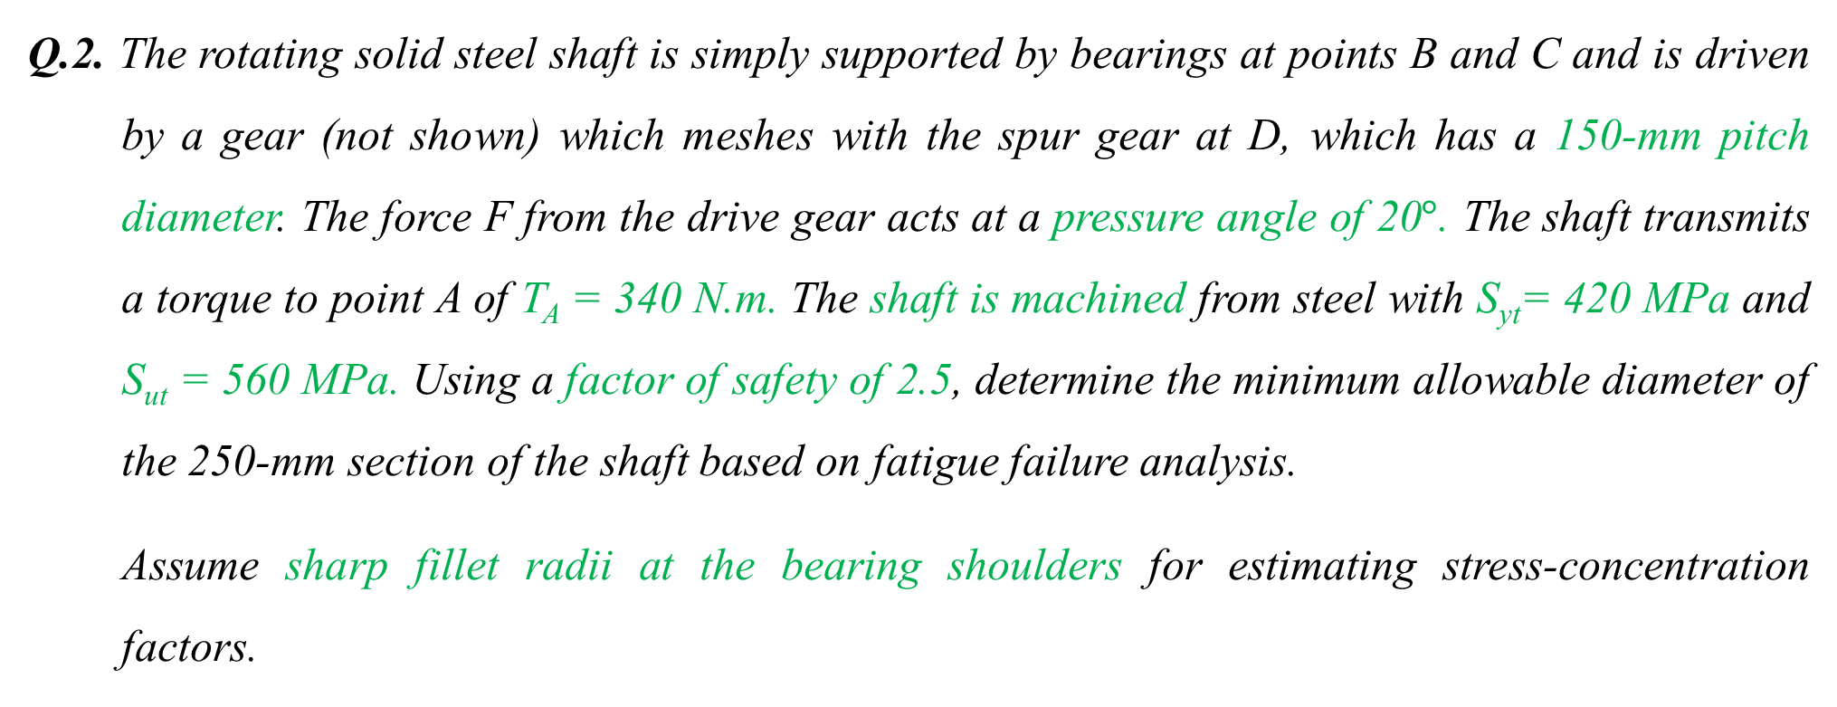
DESIGN OF SHAFT based on fatigue failure analysis
Q.2. The rotating solid steel shaft is simply supported by bearings at points B and C and is driven by a gear (not shown) which meshes with the spur gear at D, which has a 150-mm pitch diameter. The force F from the drive gear acts at a pressure angle of 20$°$. The shaft transmits a torque to point A of T_{A} = 340 N.m. The shaft is machined from steel with S_{yt}= 420 MPa and S_{ut} = 560 MPa. Using a factor of safety of 2.5, determine the minimum allowable diameter of the 250-mm section of the shaft based on fatigue failure analysis.
Assume sharp fillet radii at the bearing shoulders for estimating stress-concentration factors.

Slide 13
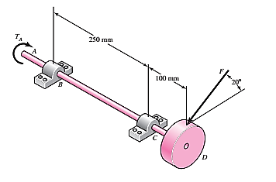
DESIGN OF SHAFT based on fatigue failure analysis
Shigley’s Book Problems 7-3

Slide 14
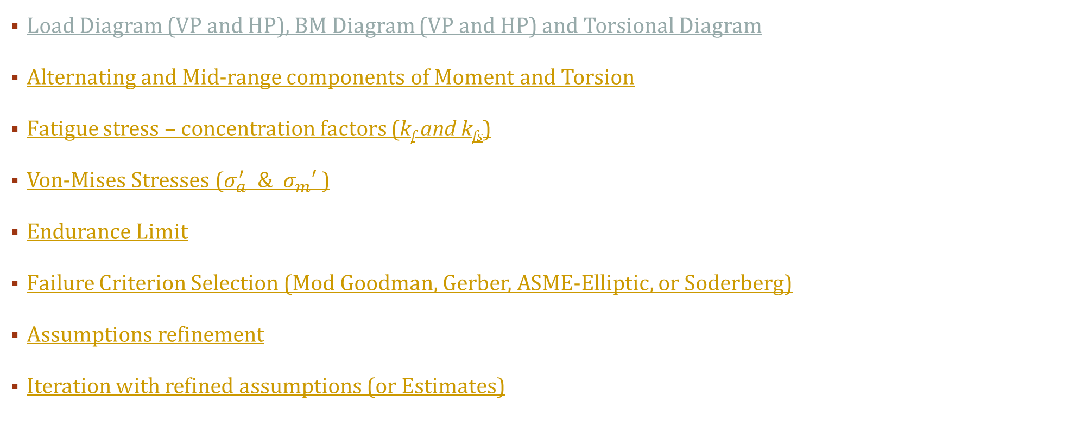
STEPS INVOLVED
Load Diagram (VP and HP), BM Diagram (VP and HP) and Torsional Diagram
Alternating and Mid-range components of Moment and Torsion
Fatigue stress – concentration factors (k_{f} and k_{fs})
Von-Mises Stresses ($σ_{a}^{′} \& σ_{m}′$)
Endurance Limit
Failure Criterion Selection (Mod Goodman, Gerber, ASME-Elliptic, or Soderberg)
Assumptions refinement
Iteration with refined assumptions (or Estimates)

Slide 15
Load Diagram (VP and HP)
y
x
Vertical Plane (Load Diagram)
Horizontal Plane (Load Diagram)
z
1650 N
x
Bz
Cz
4533.34 N
A
B
C
D
250 mm
100 mm
A
B
C
D
250 mm
100 mm
By
Cy
By = -660 N
Cy = 2310 N
Bz = 1813.33 N
Cz = -6346.67 N
Guiding Equations
By + Cy – 1650 = 0
Cy (250)-1650 (350) = 0
Guiding Equations
Bz + Cz + 4533.34 = 0
-Cz (250) – 4533.34 (350) = 0

Slide 16
Load Diagram (VP and HP)
y
x
Vertical Plane (Load Diagram)
Horizontal Plane (Load Diagram)
z
x
660 N
1650 N
1813.33 N
4533.34 N
250 mm
100 mm
A
B
C
D
A
B
C
D
250 mm
100 mm
2310 N
6346.67 N
Bending Moment Equation
M_{v}(x) = -660 x + |2310 (x-250)|
Bending Moment Equation
M_{H}(x) = -1813.33 x + |6346.67 (x-250)|

Slide 17
BM Diagram (VP and HP)
Vertical Plane (BM Diagram)
Horizontal Plane (BM Diagram)
x
Bending Moment is maximum at C, i.e. M_{c} (Resultant) = 482426.529 N.mm = 482.43 N.m
y
z
x
A
B
C
D
A
B
C
D
453332.5
165000
M_{v}(x) = -660 x + |2310 (x-250)|
M_{H}(x) = -1813.33 x + |6346.67 (x-250)|

Slide 18
Load, B.M. and Torsional Diagram (vertical and horizontal plane)
Torsional Moment Diagram
T_{A} = T_{C} = 340000 N.mm = 340 N.m
340000 N.mm
A
B
C
D

Slide 19
Alternating and MIDRANGE components
Since the shaft is rotating with constant bending moment, the bending stress is completely reversed.
M_{a} = 482.43 N.m & M_{m} = 0
Also the torsion is steady.
T_{a} = 0 & T_{m} = 340 N.m

Slide 20
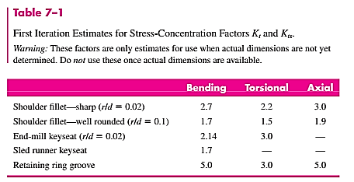
Fatigue stress concentration (k_{f} and k_{fs})
K_{f} = 1 + q (K_{t} – 1) & K_{fs} = 1 + q_{s} (K_{ts} – 1)
For sharp fillet radius, refer Table 7-1
K_{t} = 2.7 and K_{ts} = 2.2
For notch-sensitivity factor
Since fillet radius is not given;
Initially, let us assume
q = 0.8 and q_{s} = 0.9
Note:
You can assume any value of q and q_{s}.
(Later these can be checked once fillet radius is determined)
K_{f} = 2.4 & K_{fs} = 2.1

Slide 21
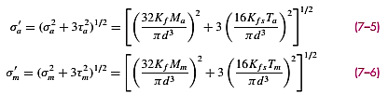


Von-mises stress ($σ_{a}^{′} \& σ_{m}^{′}$)
From above equations, we have
$σ_{a}^{′}$ = $\frac{11793.58}{d^{3}}$
$σ_{m}^{′}$ = $\frac{6298.381}{d^{3}}$

Slide 22


Determining Endurance limit (S_{e})
For endurance limit, we have
Here,
S_{e}’ = 0.5 (560) = 280 MPa

Slide 23

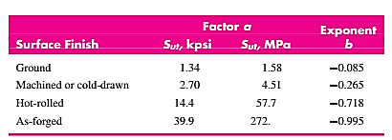
Endurance limit (S_{e})
Surface factor,
For ‘a’ and ‘b’, refer to Table 6-2
a = 4.51 and b = - 0.265
$$k_{a}=4.51 {\left(560\right)}^{−0.265}=0.84$$

Slide 24

Endurance limit (S_{e})
Size factor,
Since, diameter is unknown
So, let us assume initially
k_{b} = 0.85
(Later it can be checked once diameter is computed)

Slide 25
Endurance limit (S_{e})
Other Factors
Load modification factor, k_{c} = 1
Temperature modification factor, k_{d} = 1
Reliability factor, k_{e} =1
Miscellaneous effects modification factor, k_{f} =1
Note: Use values of 1 unless otherwise an information is given

Slide 26
Endurance limit (S_{e})
Computing Endurance Limit
Endurance Limit, S_{e} = (0.84)(0.85)(1)(1)(1)(1)(280) = 199.92 = 200 MPa (approx.)

Slide 27
Failure Criteria selection
DE – Soderberg
DE - Goodman
DE – Gerber
DE- ASME Elliptic

Slide 28


Failure Criteria selection (DE-soderberg)
According to DE-Soderberg
Replace $σ_{a}$& $σ_{m}$ with $σ_{a}^{′}$ & $σ_{m}^{′}$ respectively.
Substituting values in above equations we get,
$$\frac{11793.58}{{200×{10}^{6} d}^{3}}+\frac{6298.381}{{420×{10}^{6} d}^{3}}=\frac{1}{2.5}$$
On Solving
d = 0.057 m = 57 mm

Slide 29


Failure Criteria selection (DE-goodman)
According to DE-Goodman
Replace $σ_{a}$& $σ_{m}$ with $σ_{a}^{′}$ & $σ_{m}^{′}$ respectively.
Substituting values in above equations we get,
$$\frac{11793.58}{{200×{10}^{6} d}^{3}}+\frac{6298.381}{{560×{10}^{6} d}^{3}}=\frac{1}{2.5}$$
On solving
d = 0.056 m = 56 mm

Slide 30


Failure Criteria selection (DE-gerber)
According to DE-Gerber
Replace $σ_{a}$& $σ_{m}$ with $σ_{a}^{′}$ & $σ_{m}^{′}$ respectively.
Substituting values in above equations we get,
$$\frac{2.5×11793.58}{{200×{10}^{6} d}^{3}}+{\left(\frac{2.5×6298.381}{{560×{10}^{6} d}^{3}}\right)}^{2}=1$$
On solving
d = 0.0534 m = 53.4 mm

Slide 31


Failure Criteria selection (DE-asme elliptic)
According to DE-ASME elliptic
Replace $σ_{a}$& $σ_{m}$ with $σ_{a}^{′}$ & $σ_{m}^{′}$ respectively.
Substituting values in above equations we get,
$${\left(\frac{2.5×11793.58}{{200×{10}^{6} d}^{3}}\right)}^{2}+{\left(\frac{2.5×6298.381}{{420×{10}^{6} d}^{3}}\right)}^{2}=1$$
On solving
d = 0.05338 m = 53.38 mm

Slide 32

Refinement of assumptions
With any diameter computed above, we have to now refine our assumptions made earlier.
Let us assume d = 53.4 obtained from DE-ASME Elliptic. You can choose any obtained value of diameter.
Surface factor, $k_{a}=4.51 {\left(560\right)}^{−0.265}=0.84$ (no change)
Size factor, k_{b} = $1.51 {\left(53.4\right)}^{−0.157}=$ 0.81

Slide 33
Refinement of earlier assumptions
Assuming Sharp fillet radius, from Table 7-1
r/d = 0.02
r = 1.07 mm
K_{t} = 2.7
K_{ts} = 2.2

Slide 34
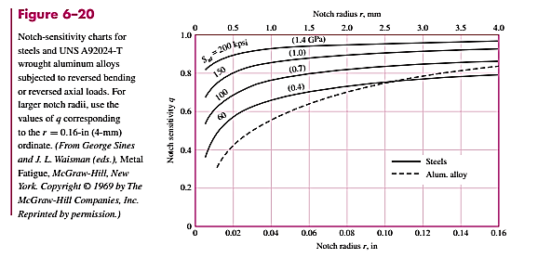
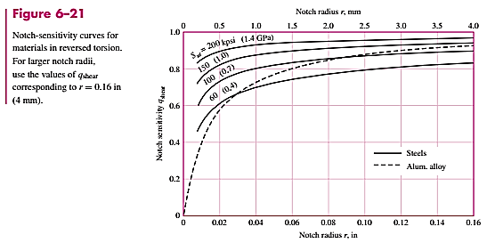
Refinement of earlier assumptions
For notch-sensitivity factor, referring to Figure 6-20 and 6-21
q = 0.7 & q_{s} = 0.75
0.7
0.75

Slide 35
Refinement of earlier assumptions
For fatigue stress-concentration factor
K_{f} = 1 + q (K_{t} – 1) & K_{fs} = 1 + q_{s} (K_{ts} – 1)
K_{f} = 1 + 0.7 (2.7 - 1) & K_{fs} = 1 + 0.75 (2.2 – 1)
So,
K_{f} = 2.19 & K_{fs} = 1.9

Slide 36
ITERATIONS WITH REFINED assumptions
Refined Endurance Limit, S_{e} = (0.84)(0.81)(1)(1)(1)(1)(280) = 190.51 MPa = 191 MPa (approx.)
Now,
Iterate the whole process of the particular failure criteria using the refined assumptions until you get the constant value of ‘d’.
After iterations, finally
d = 53 mm

Slide 37
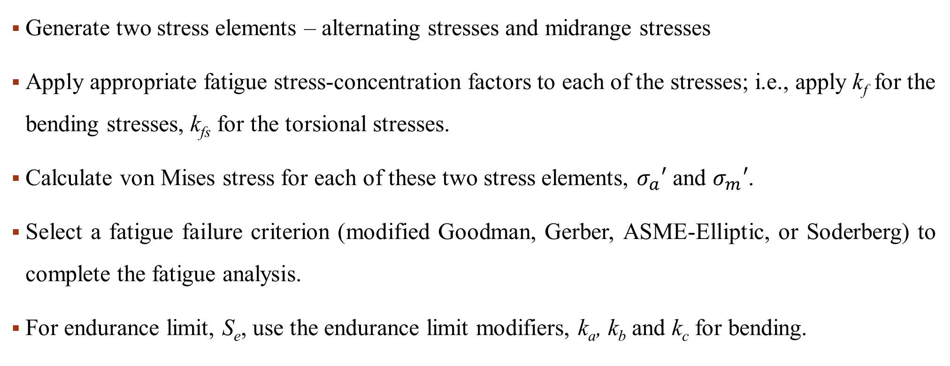
General steps in solving fatigue failure problems
Generate two stress elements – alternating stresses and midrange stresses
Apply appropriate fatigue stress-concentration factors to each of the stresses; i.e., apply k_{f} for the bending stresses, k_{fs} for the torsional stresses.
Calculate von Mises stress for each of these two stress elements, $σ_{a}′$ and $σ_{m}′$.
Select a fatigue failure criterion (modified Goodman, Gerber, ASME-Elliptic, or Soderberg) to complete the fatigue analysis.
For endurance limit, S_{e}, use the endurance limit modifiers, k_{a}, k_{b} and k_{c} for bending.

Slide 38
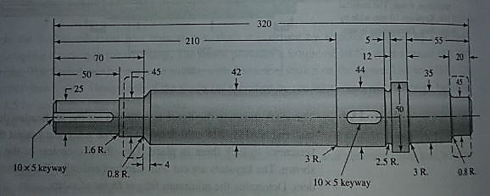
Determining fatigue factor of safety
Q.3. The shaft shown in the figure is driven by a gear at the right keyway, drives a fan at the left keyway, and is supported by two deep-groove ball bearings. The shaft is made from AISI 1020 cold-drawn steel. At steady-state speed, the gear transmits a radial load of 1.1 kN and a tangential load of 3 kN at a pitch diameter of 200 mm.
Determine fatigue factors of safety at any potentially critical locations.

Slide 39
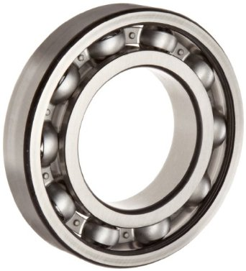
DEEP GROOVE BALL BEARINGS
Deep groove ball bearing-Single Row

Slide 40
STEPS INVOLVED
Ultimate Tensile Strength (S_{ut}) and Yeild Tensile Strength (S_{yt})
Possible critical locations
Load Diagram, BM Diagram and Torsional Diagram
Fatigue Factor of Safety at possible critical locations

Slide 41
Ultimate Tensile Strength (S_{ut}) and Yield Tensile Strength (S_{yt})
Shaft Material- AISI 1020 Cold Drawn Steel
- Refer to Table A-20 from Shigley’s Book, Page 1040
- Refer to Table 1-1 from Machine Component Design Data Handbook, Page 1
Ultimate Tensile Strength (S_{ut}) = 470 Mpa
Yield Tensile Strength (S_{yt}) = 390 MPa

Slide 42
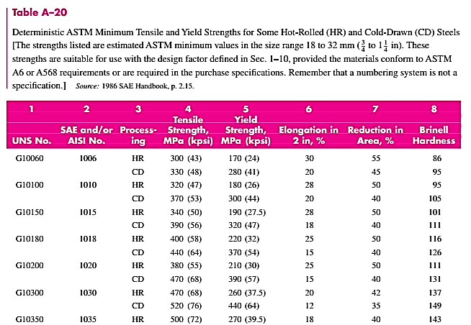
Ultimate Tensile Strength (S_{ut}) and Yield Tensile Strength (S_{yt}) Referring table
S_{ut} = 470 MPa
S_{yt} = 390 MPa

Slide 43
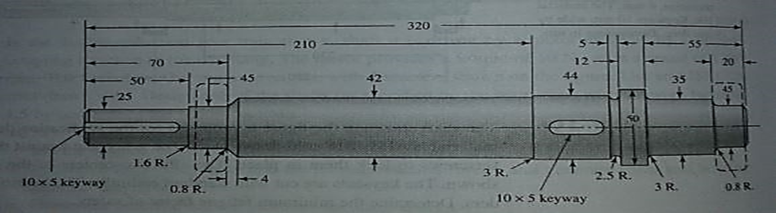
Possible critical locations
O = Reference Point
OA = 25 mm
OB = 60 mm
OC = 229 mm
OD = 250.5 mm
OE = 265 mm
OF = 310 mm
A & C = Approximate effective center of Fan and Gear respectively
B & F = Approximate effective center of Bearings
D = Groove
E = Shoulder
O
A
B
C
D
E
F

Slide 44
Load Diagram, BM DIAGRAM & TORQUE DIAGRAM Load Diagram
y
x
Vertical Plane (Load Diagram)
Horizontal Plane (Load Diagram)
z
x
B_{z}
3000 N
F_{z}
O
A
B
C
D
E
F
O
A
B
C
D
E
F
B_{y}
1100 N
F_{y}
By = -356.4 N
Fy = -743.6 N
Bz = -972 N
Fz = -2028 N
Guiding Equations
B_{y} + 1100 + F_{y} = 0
1100 (BC) + F_{y} (BF) = 0
Guiding Equations
Bz + Fz + 3000 = 0
-3000 (BC) – Fz (BF) = 0

Slide 45
Load Diagram, BM DIAGRAM & TORQUE DIAGRAM Load Diagram (CONTD…)
y
x
Vertical Plane (Load Diagram)
Horizontal Plane (Load Diagram)
z
356.4 N
743.6 N
x
3000 N
O
A
B
C
D
E
F
O
A
B
F
C
D
E
1100 N
972 N
2028 N
Bending Moment Equation (Taking B as reference)
M_{v}(x) = -356.4 x + |1100 (x-BC)|
Bending Moment Equation (Taking B as reference)
M_{H}(x) = 972 x - |3000 (x-BC)|

Slide 46
Load Diagram, BM DIAGRAM & TORQUE DIAGRAM BM Diagram
y
x
Vertical Plane (BM Diagram)
Horizontal Plane (BM Diagram)
z
x
O
A
B
C
D
E
F
O
A
B
C
D
E
F
Bending Moment Equation (Taking B as reference)
M_{v}(x) = -356.4 x + |1100 (x-BC)|
M_{v} (O) = M_{v}(A) = M_{v}(B) = 0 ;
M_{v}(C) = -60231.6 N.mm ; M_{v}(D) = -44244.2 N.mm;
M_{v}(E) = -33462 N.mm ; M_{v}(F) = 0
Bending Moment Equation (Taking B as reference)
M_{H}(x) = 972 x - |3000 (x-BC)|
M_{H} (O) = M_{H}(A) = M_{H}(B) = 0 ;
M_{H}(C) = 164268 N.mm ; M_{H}(D) = 120666 N.mm;
M_{H}(E) = 91260 N.mm ; M_{H}(F) = 0

Slide 47
Load Diagram, BM DIAGRAM & TORQUE DIAGRAM TORQUE DIAGRAM
Torsional Moment Diagram
T_{O} = T_{D} = T_{E} = 0 N.mm
T_{A} = T_{B} = T_{C} = 3000 (100) = 300,000 N.mm
O
A
B
C
D
E
F

Slide 48
Load Diagram, BM DIAGRAM & TORQUE DIAGRAM RESULTANT BM DIAGRAM & TORQUE DIAGRAM
Resultant BM Diagram
Torque Diagram
O
A
B
C
D
E
F
O
A
B
C
D
E
F
97,201.302
128,521.721
300,000
174,962.343
M_{R} (O) = M_{R}(A) = M_{R}(B) = 0 ;
M_{R}(C) = 174962.343 N.mm ; M_{R}(D) = 128521.721 N.mm;
M_{R}(E) = 97201.302 N.mm ; M_{R}(F) = 0
T_{O} = T_{D} = T_{E} = 0 N.mm
T_{A} = T_{B} = T_{C} = 3000 (100) = 300,000 N.mm

Slide 49
Fatigue Factor of safety at critical position
O
A
B
C
D
E
F
Determining factor of safety using DE-GERBER Fatigue Failure Criteria except at location A

Slide 50

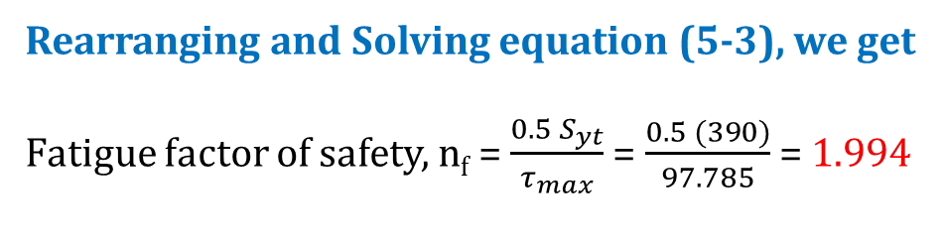
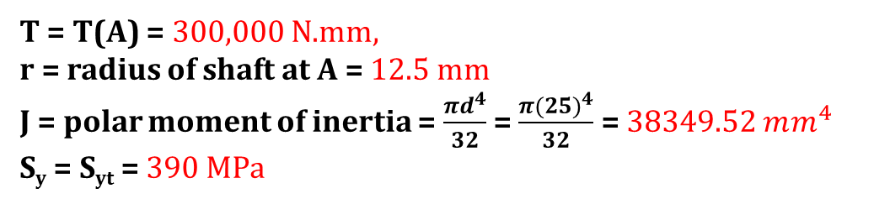

Critical location A (Keyway)
M_{R}(A) = 0
T(A) = 300,000 N.mm
Location A has only a steady high torque value, so from MSS Theory
Rearranging and Solving equation (5-3), we get
Fatigue factor of safety, n_{f} = $\frac{0.5 S_{yt}}{τ_{max}}$ = $\frac{0.5 (390)}{97.785}$ = 1.994
T = T(A) = 300,000 N.mm,
r = radius of shaft at A = 12.5 mm
J = polar moment of inertia = $\frac{πd^{4}}{32}$ = $\frac{π{(25)}^{4}}{32}$ = 38349.52 $mm^{4}$
S_{y} = S_{yt} = 390 MPa
Where, $τ_{max}= \frac{Tr}{J}$

Slide 51
Critical location C (Keyway)
Stress concentration factors
For r/d ratio, refer to Table 7-1 (Page 373)
M_{R}(C) = 174962.343 N.mm
T (C) = 300,000 N.mm
K_{t} = 2.14
K_{ts} = 3.0
r/d = 0.02
We have, d = 44. So, r = 0.02 (44) = 0.88

Slide 52
Critical location C (Keyway) (CONTD…)
For notch-sensitivity factor, referring to Figure 6-20 and 6-21
q = 0.65
q_{s} = 0.70
0.65
0.70

Slide 53
Critical location C (Keyway) (CONTD…)
Fatigue stress concentration factor, K_{f} and K_{fs}
K_{f} = 1 + q (K_{t} – 1) = 1 + 0.65 (2.14 - 1) = 1.741
&
K_{fs} = 1 + q_{s} (K_{ts} – 1) = 1 + 0.7 (3.0 - 1) = 2.4

Slide 54

Critical location C (Keyway) (CONTD…)
Endurance Limit (S_{e})
Where,
$S_{e}^{′}$ = 0.5 $×470$ = 235 MPa

Slide 55
Critical location C (Keyway) (CONTD…)
Surface Factor (K_{a})
For ‘a’ and ‘b’, refer to Table 6-2
a = 4.51 and b = - 0.265
$k_{a}=4.51 {\left(470\right)}^{−0.265}=0.8$83

Slide 56

Critical location C (Keyway) (CONTD…)
Size Factor (K_{b})
Since d = 44 mm
K_{b} = $1.24 {\left(44\right)}^{−0.107}=0.827$

Slide 57
Critical location C (Keyway) (CONTD…)
Other modifying factors
Load modification factor, k_{c} = 1
Temperature modification factor, k_{d} = 1
Reliability factor, k_{e} =1
Miscellaneous effects modification factor, k_{f} =1

Slide 58
Critical location C (Keyway) (CONTD…)
Computing Endurance Limit
Endurance Limit, S_{e} = (0.883)(0.827)(1)(1)(1)(1)(235) = 171.607 = 171.6 MPa (approx.)

Slide 59
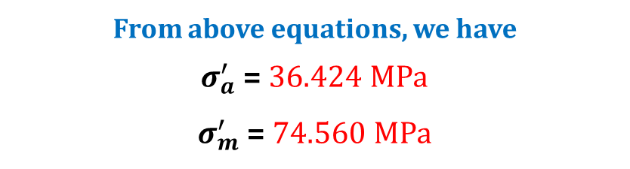
Critical location C (Keyway) (CONTD…)
Midrange and Alternating Components (Von Misses Stresses)
Torsion is steady and the constant bending moment produces completely reversed stresses,
So, M_{m} = T_{a} = 0
& M_{a} (C) = 174962.343 N.mm and T_{m} (C) = 300,000 N.mm
From above equations, we have
$σ_{a}^{′}$ = 36.424 MPa
$σ_{m}^{′}$ = 74.560 MPa

Slide 60

Critical location C (Keyway) (CONTD…)
DE- GERBER FAILURE CRITERIA
Replace $σ_{a}$& $σ_{m}$ with $σ_{a}^{′}$ & $σ_{m}^{′}$ respectively.
Substituting values in above equations we get,
$$\frac{nf×\text{36.424}}{182.4}+{\left(\frac{nf×\text{74.56}}{470}\right)}^{2}=1$$
On solving
n_{f} = 3.48

Slide 61
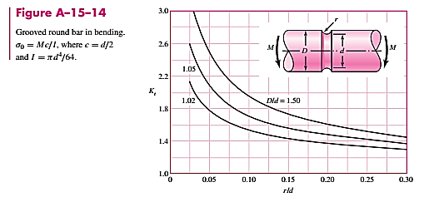
Critical location D (Groove)
M_{R}(D) = 128521.721 N.mm
T (D) = 0 N.mm
From Figure A-15-14
K_{t} = 2.05
2.05
Stress concentration factors, K_{t} and K_{ts}
For round bottom groove, refer to Figure A-15-14
r/d = 2.5/(44 - 5) = 0.064
D/d = 44/(44 - 5) = 1.128
What about the value of K_{ts} ???
K_{ts} is used for computing K_{fs}. K_{fs} is used for multiplying the value of Torque. But T(D) = 0. So, no need to compute K_{ts}

Slide 62
Critical location D (Groove) (CONTD…)
For notch-sensitivity factor, referring to Figure 6-20 and 6-21
q = 0.78
0.78
What about q_{s} ???

Slide 63
Critical location D (Groove) (CONTD…)
Fatigue stress concentration factor, K_{f} and K_{fs}
K_{f} = 1 + q (K_{t} – 1) = 1 + 0.78 (2.05 - 1) = 1.82
&
K_{fs} = 1 + q_{s} (K_{ts} – 1) = … ???

Slide 64
Critical location D (Groove) (CONTD…)
Endurance Limit (S_{e})
Where,
$S_{e}^{′}$ = 0.5 $×470$ = 235 MPa

Slide 65
Critical location D (Groove) (CONTD…)
Surface Factor (K_{a})
For ‘a’ and ‘b’, refer to Table 6-2
a = 4.51 and b = - 0.265
$k_{a}=4.51 {\left(470\right)}^{−0.265}=0.8$83

Slide 66

Critical location D (Groove) (CONTD…)
Size Factor (K_{b})
Since d = 39 mm
K_{b} = $1.24 {\left(39\right)}^{−0.107}=0.83$8

Slide 67
Critical location D (Groove) (CONTD…)
Other modifying factors
Load modification factor, k_{c} = 1
Temperature modification factor, k_{d} = 1
Reliability factor, k_{e} =1
Miscellaneous effects modification factor, k_{f} =1

Slide 68
Critical location D (Groove) (CONTD…)
Computing Endurance Limit
Endurance Limit, S_{e} = (0.883)(0.838)(1)(1)(1)(1)(235) = 173.889 = 174 MPa (approx.)

Slide 69
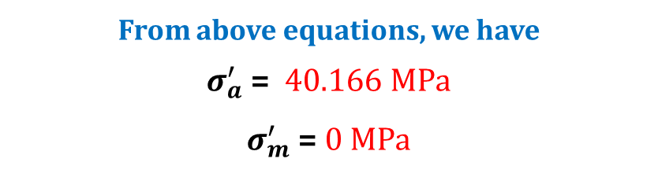
Critical location D (Groove) (CONTD…)
Midrange and Alternating Components (Von Misses Stresses)
Torsion is steady and the constant bending moment produces completely reversed stresses,
So, M_{m} = T_{a} = 0
& M_{a} (D) = 128521.721 N.mm and T_{m} (D) = 0 N.mm
From above equations, we have
$σ_{a}^{′}$ = 40.166 MPa
$σ_{m}^{′}$ = 0 MPa

Slide 70

Critical location D (Groove) (CONTD…)
DE- GERBER FAILURE CRITERIA
Replace $σ_{a}$& $σ_{m}$ with $σ_{a}^{′}$ & $σ_{m}^{′}$ respectively.
Substituting values in above equations we get,
$$\frac{nf×\text{40.166}}{174}+{\left(\frac{nf×\text{0}}{470}\right)}^{2}=1$$
On solving
n_{f} = 4.332

Slide 71
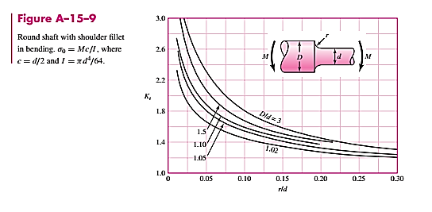
Critical location E (Shoulder)
M_{R}(E) = 128521.721 N.mm
T (E) = 0 N.mm
From Figure A-15-9
K_{t} = 1.7
Stress concentration factors, K_{t} and K_{ts}
1.7
For round bottom groove, refer to Figure A-15-9
r/d = 3/35 = 0.086
D/d = 50/35 = 1.43
What about the value of K_{ts} ???
K_{ts} is used for computing K_{fs}. K_{fs} is used for multiplying the value of Torque. But T(E) = 0. So, no need to compute K_{ts}

Slide 72
Critical location E (Shoulder) (CONTD…)
For notch-sensitivity factor, referring to Figure 6-20 and 6-21
q = 0.79
0.79
What about q_{s} ???

Slide 73
Critical location E (Shoulder) (CONTD…)
Fatigue stress concentration factor, K_{f} and K_{fs}
K_{f} = 1 + q (K_{t} – 1) = 1 + 0.79 (1.7 - 1) = 1.553
&
K_{fs} = 1 + q_{s} (K_{ts} – 1) = … ???

Slide 74
Critical location E (Shoulder) (CONTD…)
Endurance Limit (S_{e})
Where,
$S_{e}^{′}$ = 0.5 $×470$ = 235 MPa

Slide 75
Critical location E (Shoulder) (CONTD…)
Surface Factor (K_{a})
For ‘a’ and ‘b’, refer to Table 6-2
a = 4.51 and b = - 0.265
$k_{a}=4.51 {\left(470\right)}^{−0.265}=0.8$83

Slide 76

Critical location E (Shoulder) (CONTD…)
Size Factor (K_{b})
Since d = 35 mm
K_{b} = $1.24 {\left(35\right)}^{−0.107}=0.84$8

Slide 77
Critical location E (Shoulder) (CONTD…)
Other modifying factors
Load modification factor, k_{c} = 1
Temperature modification factor, k_{d} = 1
Reliability factor, k_{e} =1
Miscellaneous effects modification factor, k_{f} =1

Slide 78
Critical location E (Shoulder) (CONTD…)
Computing Endurance Limit
Endurance Limit, S_{e} = (0.883)(0.848)(1)(1)(1)(1)(235) = 175.964 = 176 MPa (approx.)

Slide 79
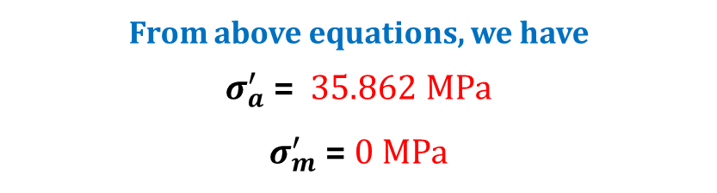
Critical location E (Shoulder) (CONTD…)
Midrange and Alternating Components (Von Misses Stresses)
Torsion is steady and the constant bending moment produces completely reversed stresses,
So, M_{m} = T_{a} = 0
& M_{a} (E) = 97201.302 N.mm and T_{m} (E) = 0 N.mm
From above equations, we have
$σ_{a}^{′}$ = 35.862 MPa
$σ_{m}^{′}$ = 0 MPa

Slide 80

Critical location E (Shoulder) (CONTD…)
DE- GERBER FAILURE CRITERIA
Replace $σ_{a}$& $σ_{m}$ with $σ_{a}^{′}$ & $σ_{m}^{′}$ respectively.
Substituting values in above equations we get,
$$\frac{nf×\text{35.862}}{176}+{\left(\frac{nf×\text{0}}{470}\right)}^{2}=1$$
On solving
n_{f} = 4.908

Slide 81
!!! THANK YOU !!!

